Slide 1
Linear Regression Part 1
Adwait

Slide 2
What is a model?
Representation of some phenomenon/process
Expressed in logical or maths language
Common type – describes relationship between variables.
Helps you in understanding the process and do the estimation or prediction.

Slide 3
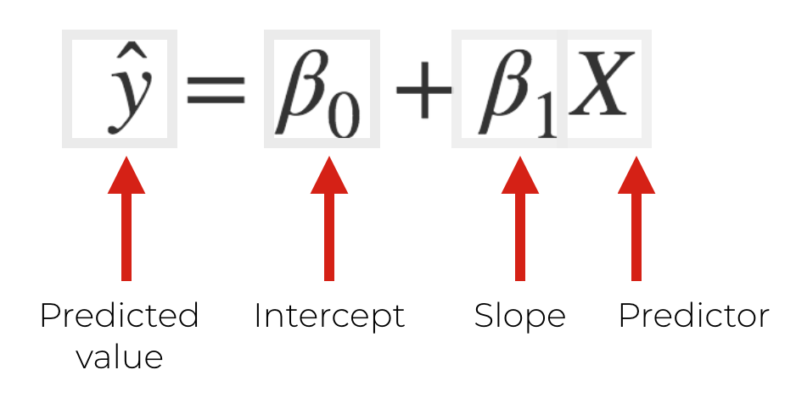
Linear Model
Linear assumption
Dependent and Independent Variable
Easy to interpret, generalize to multiple variables.
Notes:
Ref : https://www.sharpsightlabs.com/blog/linear-regression-in-r/

Slide 4
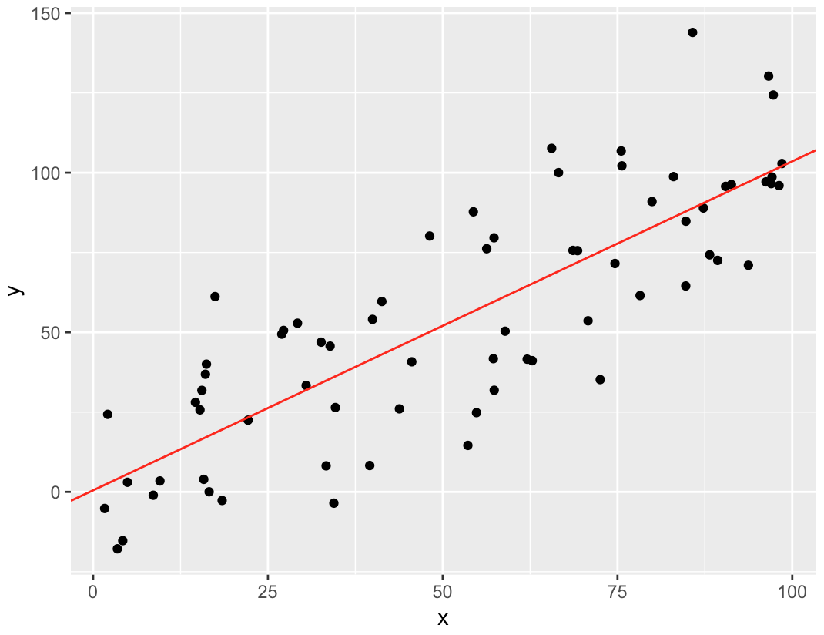
Linear Equation
Understanding
Slope
Intercept
Finding line that fits the points with least error.
Finding Slope and Intercept of a line.
How can we predict the response variable?

Slide 5
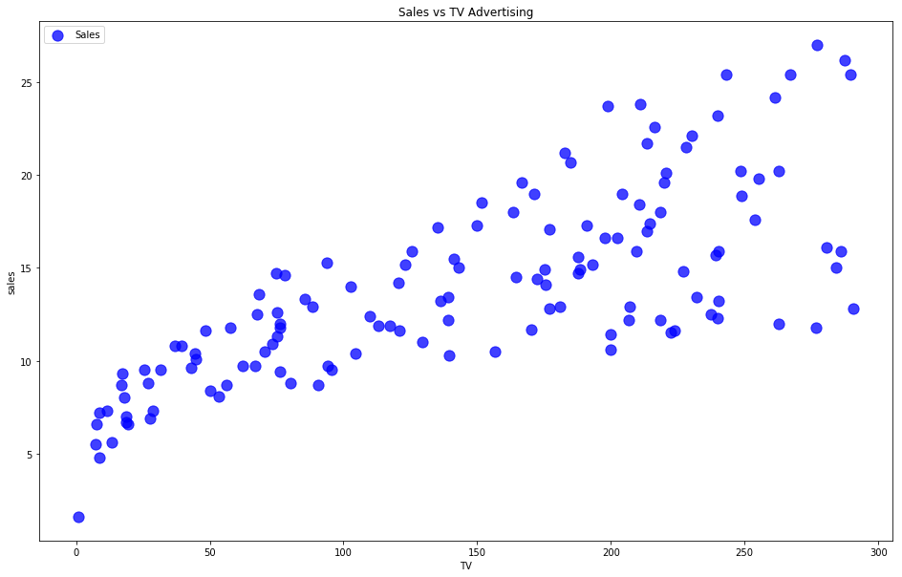
Challenge

Slide 6
Ideas
Predicted Y = linear equation (X)
‘Best Fit’ means difference between actual Y values & predicted Y values is minimum over all (X,Y) pairs.
What do you mean by ‘best fit’?
System of simultaneous linear equations.
How many equations you have?

Slide 7
Goodness of fit
y = (y1, · · · , yn) = data values of the response variable.
yˆ = (yˆ1, · · · , yˆn) = ‘fitted values’ of the response variable.
TSS = X(yi − y) 2 = total sum of squares = total variation.
RSS = X(yi − yˆi) 2 = residual sum of squares.
RSS = unexplained by model squared error (due to random fluctuation)
RSS/TSS = unexplained fraction of the total error.
R 2 = 1 − RSS/TSS is measure of goodness-of-fit
R 2 is the fraction of the variance of y explained by the model.

Slide 8
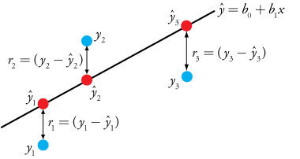
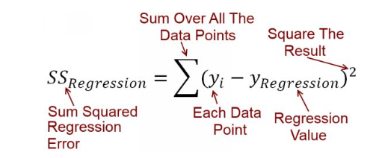
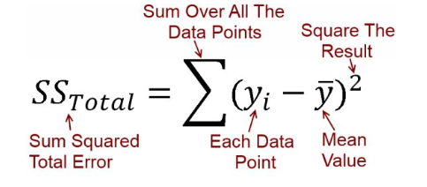
Understanding Error

Slide 9
Process
Divide dataset in Train and Test
Find a best fit line (‘linear model’) on Train
Using this model, predict values for response variable.
Compare error on train and test.
Evaluate Goodness of fit.

Slide 10
Multiple linear regression
In simple regression we found the following equation
Sales = b0 + b1*(TV)
In simple regression we found the following equation
Sales = b0 + b1*(TV) + b2*(News) + b3*(Radio)

Slide 11
Thanks!

